Slide 1

Multiple Table Queries

Slide 2
Agenda
SL
Introduction to Joins with ER Diagram
Types of Joins
Simple Joins
Natural Joins
Equi Joins
Non Equi Join
Self Join
Left & Right Join
Inner & Outer Join

Slide 3
Introduction
SL
JOIN clause allows to retrieve the data from two or more tables having related data
These relations are established or identified with the help of key attributes
In other words, Facts and Dimensional tables are joined using Key columns to produce an output of records with more meaningful relationships between each data fields

Slide 4

SL
Fact table consists of real time data, usually static in nature, and do not change frequently.
E.g Customer data is single and do not change all the time
Dimension tables consists of data that is changed more frequently than the fact tables.
E.g : Transaction data which is frequently updated

Slide 5
Introduction
SL
Consider the following two tables Customer and Account:
Customer
cust_id
name
address
contact_num
Account
cust_id
savings
deposits
credit_card
JOIN clause will help to establish relationship between the two tables CUSTOMER and ACCOUNT and present all the details of accounts held by one single customer

Slide 6

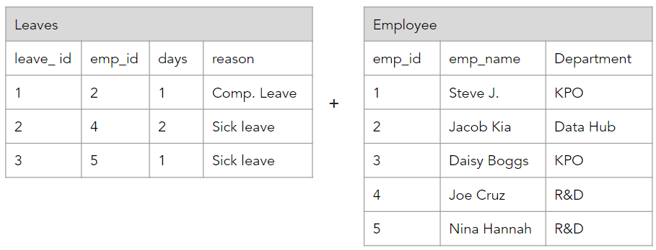
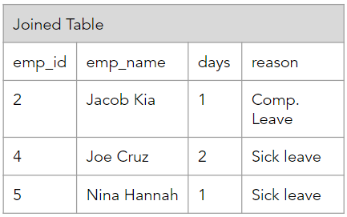
SL
With JOINs, queries avoids a lot of repetition of the data and able to present it in a more systematic way
=

Slide 7
Introduction
SL
In a bank database, Strategic mgt. analyzes the customers using their debit-card transactions occurred through various channels using Joins to understand customer expectation
Few relationships between customers , accounts and transactions table are below:
How many accounts are maintained by each customer?
Different modes of customer payments?
Customer using Smart cash (digital) payment via various channels including UPI, IVR, point_of_sale?

Slide 8
Introduction
The ISO standard defines following JOIN clauses that are commonly used by all.
Self - Join or equi - Join
Non - Equi Join
Natural Join
Inner Join
Left Outer Join
Right Outer Join

Slide 9
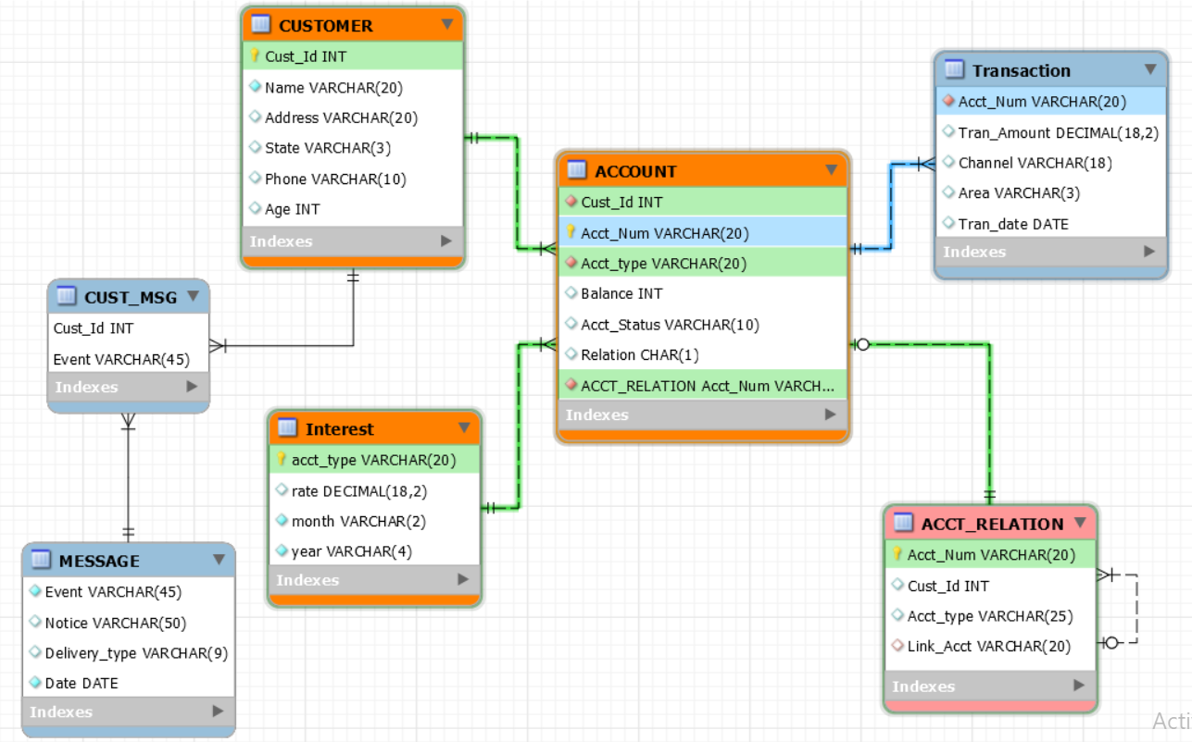
ER Diagram for the study
Please consider the following ER diagram for our study:

Slide 10
ER Diagram
CUSTOMER | Cust_id | Customer is Uniquely considered in the bank. Hence defined as Primary key.
 | Name | Customer Name
 | Address | Address of a customer.
 | State | State code of customer residence
 | Phone | Personal phone details

Slide 11
ER Diagram
ACCOUNT | Cust_id | Customer can have multiple Accounts. Hence it is a referenced by CUSTOMER table. ( Foreign Key)
 | Acct_Num | Account Number is uniquely represented in bank. ( Primary key)
 | Acct_type | Type of Account: Savings, Deposit & Credit card
 | Balance | Balance Amount that is maintained in an account
 | Acct_status | Status becomes ACTIVE or INACTIVE accounts over unused.
 | Relation | Defines Primary (P) or Secondary (S) . E.g: A Deposit Account is Secondary relation and is always depend on primary - Savings Account.

Slide 12
ER Diagram
TRANSACTION | Acct_Num | Account Number ( NON - unique key ) . Because an account is transacted for multiple times.
 | Tran_Amount | Transaction Amount in Numbers
 | Channel | Mode of transfer: E.g: ATM Cash Withdrawal, Cash Deposits, Online Shopping.
 | Area | In which area ( state code) , the transaction taken place.
 | Tran_date | Date of Transaction

Slide 13
ER Diagram
ACCT_RELATION | Acct_Num | Account Number is uniquely represented in bank. ( Primary key)
 | Cust_id | Customer Identify of any Account
 | Acct_type | Type of Account: Savings, Deposit & Credit card
 | Link_Acct | E.g: A Deposit Account is linked to Savings Account (or) A Credit card is linked to Savings Account. Here, Savings Account is the Link_Acct.

Slide 14
ER Diagram
INTEREST | Acct_type | Type of Account: Savings, Deposit & Credit card
 | Rate | Rate of interest that is defined for each type : Savings, Deposits and Credit card.
 | month | Month ( 1, 2,3 ,4,…. ,12 )
 | Year | Defines the year . ( 2020, 2021 ,... )
MESSAGE | Event | Any upcoming Event occuring in the bank.
 | Notice | Pre- defined Notice message needs to be delivered to a customer when a sudden event occurs.
 | Delivery_Mode | Mode of delivering a message to customer. E.g : message via phone or e-mail.
 | Date | Date of the event

Slide 15
ER Diagram
All these tables can be found under ‘module 6 tables.sql’ file which will be required for this session

Slide 16
Two Table Query Example

Slide 17
Two Table Query
Business needs more complex reports than simple reports to understand relationships between different facts and dimensional tables
The next example shows how two tables are accessed via SELECT query and will drill down how it works

Slide 18
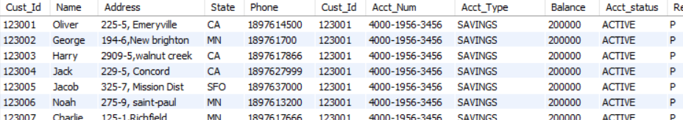
A two table query example
CUSTOMER and ACCOUNT are two different tables which are allowed to access via SELECT query to see multiple combinations of data between them
SELECT * FROM CUSTOMER, ACCOUNT;
The output gives the multiple combinations of data between CUSTOMER and ACCOUNT

Slide 19
Simple Joins

Slide 20
Table and Column aliases
Table & Column aliases are useful when a SELECT query is using similarly named columns from two different tables
Aliases are given for tables and as well as for columns
It represents similar column names with different meaning in SELECT clauses
Aliases are also given for a complete SELECT query when it is referred as a derived table, which we will come across in other sessions

Slide 21
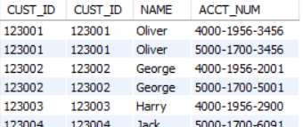
Without aliases
Without aliases , the full length of table names should be mentioned in WHERE clause conditions and in SELECT clause
SELECT CUSTOMER.CUST_ID,ACCOUNT.CUST_ID, NAME, ACCT_NUM
FROM CUSTOMER, ACCOUNT
WHERE CUSTOMER.CUST_ID = ACCOUNT.CUST_ID;
Output:

Slide 22
With aliases
When the two tables, CUSTOMER & ACCOUNT, are JOINED using common key column: “cust_id” , MYSQL finds difficulty to represent the cust_id from either of these two tables. Hence it is mandatory to provide table name before the column
E.g : CUSTOMER.CUST_ID , ACCOUNT.CUST_ID
In order to simplify the table reference,
CUSTOMER table is represented with table alias as "BC" .
ACCOUNT table is represented with table alias as “AC” .

Slide 23
Table and Column aliases
Example:
SELECT BC.cust_id AS Master_Cust_Id,
BA.cust_id AS Account_Cust_Id,
Name AS Customer_Name,
Acct_Num AS Account_Number
FROM CUSTOMER BC, ACCOUNT BA
WHERE BC.CUST_ID = BA.CUST_ID;

Slide 24
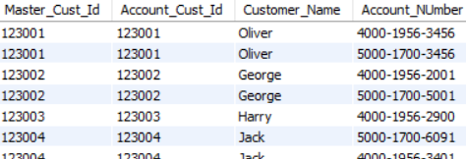
Table and Column aliases
Here, the cust_id in CUSTOMER and ACCOUNT is referred with table aliases and column aliases

Slide 25
While table aliases simplifies the names of tables, column alias will simplify the SELECT query columns with more meaningful representation

Slide 26
Parent - Child Relationship Queries

Slide 27
Parent - Child Relationship Queries
A same table is referred in a SELECT query for multiple times to establish parent - child relationships
The table when called for first time acts like a parent and the same table acts like a child when it is called for second time and so on
This is useful when we need to find hierarchical data and relationship between two records in the same table

Slide 28
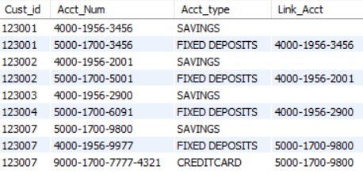
Parent - Child Relationship Queries
Consider the following ACCT_RELATION table created earlier:
The column Acct_Num holds all type of accounts. Link_Acct field shows parent relationship with the account number.

Slide 29
Parent - Child Relationship Queries
The below query can be used to display the primary and secondary account types for a single account number:
SELECT AR1.Acct_Num as Primary_Account,
AR1.Acct_Type as Primary_Acct_Type,
AR2.Acct_Num as Secondary_Account,
AR2.Acct_Type as Secondary_Acct_Type
FROM ACCT_RELATION AR1,
ACCT_RELATION AR2
WHERE AR1.Acct_Num = AR2.Link_Acct ;

Slide 30
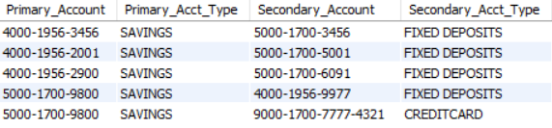
Parent - Child Relationship Queries
Output:
The result shows that “FIXED DEPOSITS” and “Credit card” are child accounts of the parent “savings” account

Slide 31
Joins with Row Selection Criteria

Slide 32
Joins with Row Selection Criterion
Rows returned from a SELECT Query can also act like a temporary table or a derived table where it can be joined with any other physical table.

Slide 33
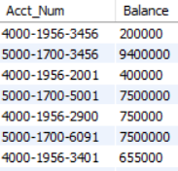
Joins with Row Selection Criterion - Example-1
In the below example, the independent query in the FROM clause acts like a temporary table which in turn used like a row source data by main SELECT query
Syntax:
SELECT BA.Acct_num, BA.Balance FROM ( Select * FROM ACCOUNT ) BA;
Output:

Slide 34
Joins with Row Selection Criterion - Example-2
In the below example, we will understand how the row source data is used in JOINS.
Here , the result set of an independent SELECT query results are used as a temporary table in the INNER JOIN condition and then later joined with main Query
Syntax:
SELECT BA.Acct_Num ,
BA.Acct_Type,
AT.Tran_amount
FROM ACCOUNT BA, ( SELECT * from TRANSACTION) AT
WHERE BA.Acct_Num = AT.Acct_Num;

Slide 35
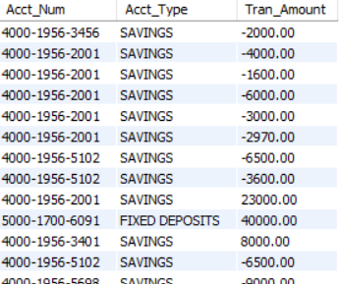
Joins with Row Selection Criterion - Output

Slide 36
Multiple columns of one table can match with other tables. Here the multiple columns used for joining are said be composite joining key to reference another table.
“Acct_NUM” and “Acct_type” and “balance” Columns in ACCOUNT table are used as composite join key to represent other table: TRANSACTION.
SELECT BA.Acct_Num, BA.Acct_type, BA.Balance, TR.Tran_Amount
FROM ACCOUNT BA
JOIN TRANSACTION TR
ON ( BA.Acct_Num = TR.Acct_Num AND BA.Balance > abs(TR.Tran_Amount)
AND BA.Acct_type like '%DEPOSIT%' )

Slide 37

Output:
In this example, Bank is trying to know the Account balance is greater than the transaction amount, and for DEPOSIT type accounts only

Slide 38
Natural Joins

Slide 39
Natural join
A Natural JOIN maps the rows implicitly among common columns in both the tables defined in the FROM clause
It is best to use when there is a need for joining with all of the common columns between the two tables and retrieve full set of columns from both the tables.
Developer need not be aware of the columns that are used for Joining the tables.

Slide 40
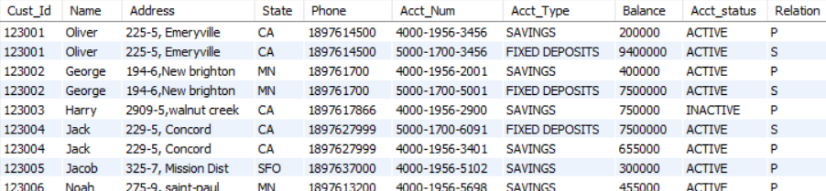
Natural join
NATURAL JOIN implicitly joins CUSTOMER and ACCOUNT tables using CUST_ID
SELECT * FROM CUSTOMER NATURAL JOIN ACCOUNT
Output:
The output of this query gives all columns in both the tables

Slide 41
Natural joins usually takes all the key columns of the first table and then tries to match with other table columns

Slide 42
There are certain restriction on Natural joins:
Natural Joins needs curated data in the common columns which means all the common columns should have unique data without duplicates
With Natural Joins Chances are high in retrieving too many rows without meaningful relationships because of duplicate values in Joining key columns
Natural joins cannot handle NULL values in Joining key columns since it matches the column values implicitly by SQL and are not written in the SQL queries

Slide 43
Queries with three or more tables
SELECT statements can be written by joining three or more tables to understand much more relationships between business entities

Slide 44
Queries with three or more tables
A strategic team tries to understand all customer details, bank accounts, and the relationship between accounts and its transactions
SELECT * FROM CUSTOMER NATURAL JOIN ACCOUNT NATURAL JOIN TRANSACTION;
A NATURAL JOIN is used to join all the three tables by matching the common rows
Here in the example:
Cust_Id is common key column between CUSTOMER and ACCOUNT
Acct_Num is common key column between ACCOUNT and TRANSACTION

Slide 45
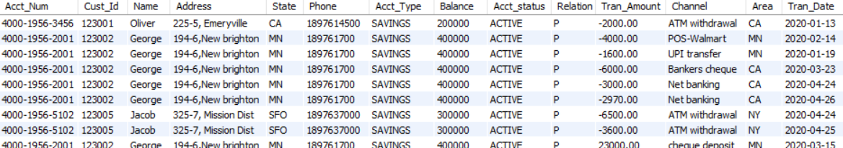
Queries with three or more tables
The output of the query gives all matching rows of three tables:

Slide 46
Other equi-joins
Like NATURAL JOIN, the EQUI-JOIN / Inner JOIN also matches the rows using common key columns between tables
The only difference with equi-joins and NATURAL join is, joining key columns are explicitly specified
Equi - JOIN otherwise called INNER JOIN is simply defined with JOIN / INNER JOIN clause between two tables but essentially defines with an equal (=) operator.

Slide 47
Other equi-joins
Equi-Joins / INNER JOINS efficiently handles NULL values and comparisons
Assign default values by replacing NULL values in joining key columns, and ensures the records are not dropped in the output
SELECT BA.Acct_Num, BA.Acct_type, BA.Balance, TR.Tran_Amount
FROM ACCOUNT BA
JOIN TRANSACTION TR
WHERE BA.Acct_Num = TR.Acct_Num AND ifNULL(BA.BALANCE, 0) = TR.Tran_Amount

Slide 48

Other equi-joins
Output:
JOIN clause with an equal (=) operator joins two tables ACCOUNT and TRANSACTION using common key column: Acct_num
In first account number , Balance column has Null value which replaced with ‘0’ in order to compare with tran_amount

Slide 49
Other equi- Joins
Equi - Join can also be implemented with USING clause which replaces WHERE and equal operator (=)
SELECT cust_id,Name, Acct_Num
FROM CUSTOMER
JOIN ACCOUNT
USING (CUST_ID)
The output of this Query gives all matching records of CUSTOMER and ACCOUNT by joining with common key : Cust_Id

Slide 50
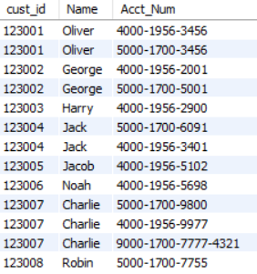
Other equi- Joins
Output:
USING clause identifies the common joining key columns in both tables and produces matching rows

Slide 51
Non Equi Joins

Slide 52
Non Equi- Joins
Non equi-JOINS uses comparison operators like >, < , NOT , <> in order to filter the records in one table and map the remaining rows across the other table rows
It is widely used for creating different dimensional reports

Slide 53
Non Equi- Joins
Below is an example of Non equi JOIN with range operator “>” that filters lower interest_rates and provide higher privileged interest-rate to all deposit / saving holders
SELECT AC.Acct_Num, AC.Acct_type, IR.Rate Modified_rate, IR.Acct_type Interest_type
FROM ACCOUNT AC
JOIN INTEREST IR
WHERE IR.RATE > 0.07 AND AC.Acct_Type NOT LIKE '%CARDS%'

Slide 54
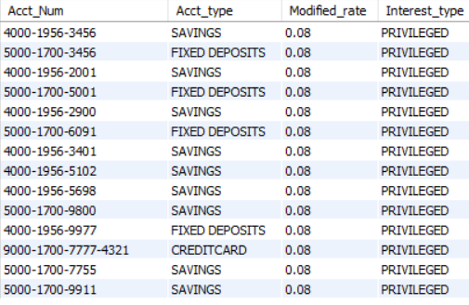
Non Equi- Joins
Interest rates are lower for Accounts, so bank decided to provide higher interest rate called privileged interest rate greater than 7%
NOT LIKE is used to filter CREDIT CARD accounts

Slide 55
SQL Consideration for Multiple Queries

Slide 56
Qualified Column Names
SL
Qualified names of the tables or columns in the Database plays a vital role in data modeling
Data architects and Business Analysts easily design the models and make a clear lineage of the Business flow process
Qualified names are the standards established by Data management and Governance, and banking authorities

Slide 57
Qualified Column Names - Example
SL
CUSTOMER is a table which is a qualified name in the Bank which consists of only customer details and is not conflicting with any other different terms
Similarly Cust_Id , Name columns represent unique customer details
SELECT Cust_Id, Name, Address FROM CUSTOMER

Slide 58
All Column Selection
SL
Any RDBMS including MySQL allows to create more than 250 columns in a table which depends on size of individual column
However it depends on Business usage
For ex: TRANSACTION table can be defined with at least 50 columns because these days we are doing payments in different modes unlike conventional methods to go bank and withdraw money
In such cases when there are more columns to represent, a wildcard " * " can be used to select all columns in the table
Ex: SELECT * FROM CUSTOMER

Slide 59
Self Join

Slide 60
SELF JOIN - Syntax
SELF JOIN is usually applied when we see meaningful data in a same table
Self join means joining the same table to itself for multiple times
Below is the query that is used to produce comparative results for the current month and previous month side by side
SELECT T1.Acct_Num as Account,
T1.Tran_date current_month,
T1.Tran_Amount Latest_transaction,
T2.Tran_date previous_month,
T2.Tran_Amount Previous_transaction
FROM TRANSACTION T1
JOIN TRANSACTION T2
ON T1.Acct_Num = T2.Acct_Num AND T1.Tran_date > T2.Tran_date

Slide 61
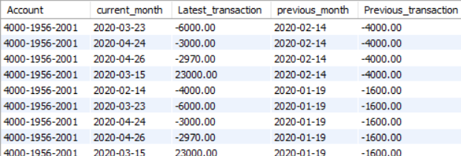
SELF JOIN - Syntax
Both T1 and T2 tables referring to same TRANSACTION table
With this SELF JOIN , query produced the comparative results side by side for the current and previous month details from one single TRANSACTION table

Slide 62
INNER JOIN

Slide 63
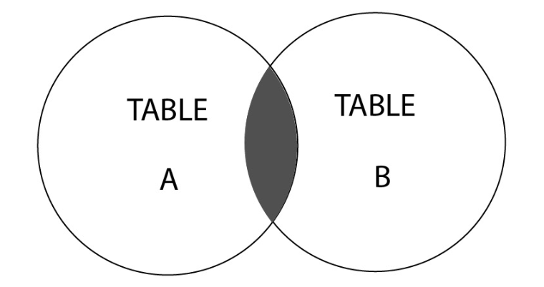
What is an INNER JOIN?
SL
The INNER JOIN is the default type of join that is used to select matching rows in both tables using common key joining column
It can be represented with the following Venn diagram:
The INNER JOIN represents the highlighted section, which is the intersection between these two tables. Intersection part is the matching rows.

Slide 64
INNER JOIN - Syntax
Syntax:
SELECT column_name(s)
FROM table1
INNER JOIN table2
ON table1.column_name = table2.column_name;

Slide 65
INNER JOIN - Example
If you want to know the Customers and their account details by joining CUSTOMER and ACCOUNT table using customer_id – common key column
SELECT BC.cust_id, BC.name, BA.Acct_Num, BA.Balance
FROM CUSTOMER BC
INNER JOIN ACCOUNT BA
ON BC.cust_id = BA.cust_id
INNER JOIN ensures there are matching records in both tables based on CUST_ID, and can retrieve all the fields from Customer and Account tables.

Slide 66
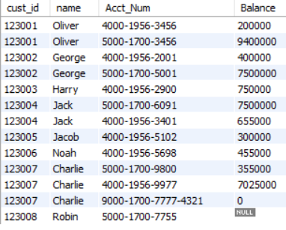
INNER JOIN - Example
Output:
The output of this query consists of records if and only if cust_id exists in both the tables

Slide 67
LEFT JOIN

Slide 68
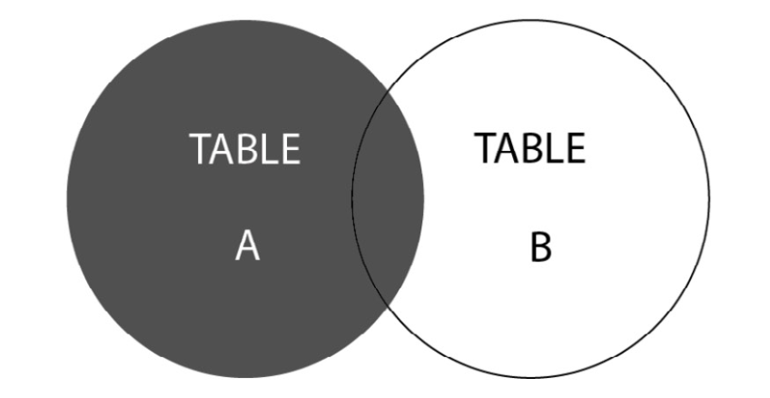
What is a LEFT JOIN?
SL
The LEFT JOIN is used when you want to select
Matching records that are selected from both the tables and
All the valid records from the left table with Null assignment of columns in the right table
The LEFT JOIN represents the highlighted section from TABLE A and the intersected section from TABLE B

Slide 69
LEFT JOIN - Syntax
Syntax:
SELECT [Column List]
FROM [Table 1] LEFT OUTER JOIN [Table 2]
ON [Table 1 Column Name] = [Table 2 Column Name]
WHERE [Condition]
The OUTER word in the query is optional
This type of join is very similar to the normal JOIN, with the only difference being that it pulls complete details of Left table

Slide 70
LEFT JOIN - Example
If you want to retrieve all customer accounts in the bank though there are no transactions occurred:
SELECT BA.Acct_Num, BA.Balance,BT.Acct_Num as Tran_Account, BT.Tran_Amount,
BT.Channel
FROM ACCOUNT BA
LEFT JOIN TRANSACTION BT
ON BA.Acct_Num =BT.Acct_Num order by 1;

Slide 71
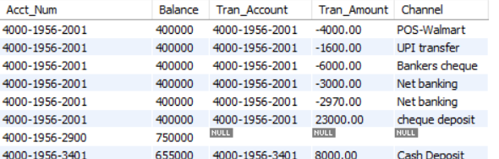
LEFT JOIN - Example
Output:
LEFT JOIN extracts matching records from both tables based on ACCOUNT_NUMBER
For unmatched records, it pulls all the account records from left table i.e. ACCOUNT, and shows NULL values for fields in the right table : TRANSACTION as there are no transaction records

Slide 72
RIGHT JOIN

Slide 73
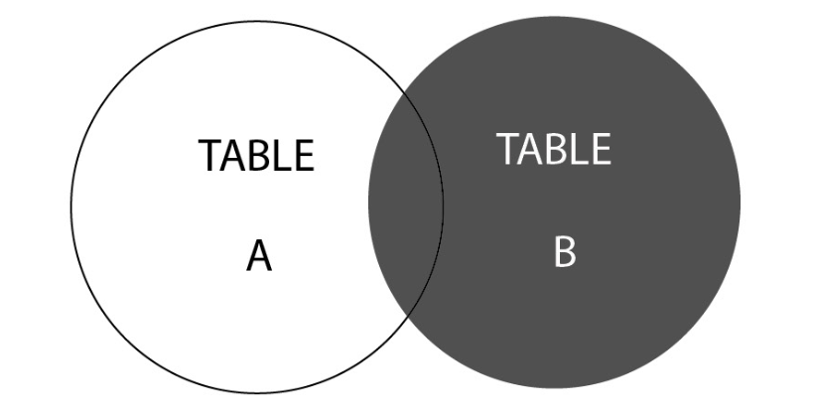
What is a RIGHT JOIN?
SL
The RIGHT JOIN is used when you want to select
Matching records from both the tables and
All the valid records from the right table with Null assignment of columns in the left table
The RIGHT JOIN represents the highlighted section, that is, TABLE B, and the intersected section of TABLE A.

Slide 74
RIGHT JOIN - Syntax
Syntax:
SELECT [Column List]
FROM [Table 1] RIGHT OUTER JOIN [Table 2]
ON [Table 1 Column Name] = [Table 2 Column Name]
WHERE [Condition]
The OUTER word in the query is optional

Slide 75
RIGHT JOIN - Syntax - ERROR
Use the following query retrieve any money transactions that do not exist in ACCOUNT table but exist in TRANSACTION table
Usually, we will see such transactions when customer do not pay credit card bills but the credit card Account is expired or inactive
SELECT BA.Acct_Num,
BA.Balance,
BT.Acct_Num as Tran_Account,
BT.Tran_Amount,
BT.Channel
FROM ACCOUNT BA
RIGHT JOIN TRANSACTION BT
ON BA.Acct_Num = BT.Acct_Num

Slide 76
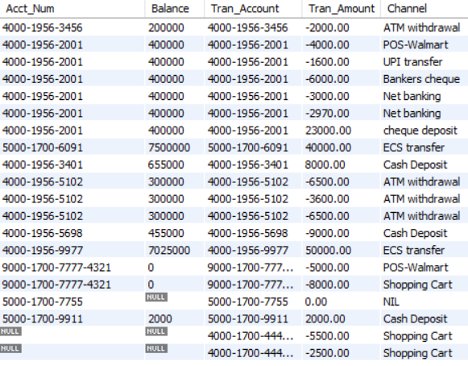
RIGHT JOIN - Example
Output:
Using RIGHT Join, though the accounts that are not present in ACCOUNT table, their transactions are still exist in Transaction table
In order to catch such pending transactions, especially CREDIT cards, we can apply RIGHT JOIN

Slide 77
FULL OUTER JOIN

Slide 78
FULL OUTER JOIN - Syntax - ERROR
Full outer Joins helps to retrieve combination of LEFT and RIGHT join results
Retrieve result set of ALL active accounts in Bank from LEFT JOIN
Retrieve result set of ALL transactions in Bank from RIGHT JOIN
SELECT BA.Acct_Num, BT.Acct_Num as Tran_Account, BT.Tran_Amount
FROM ACCOUNT BA
LEFT JOIN TRANSACTION BT
ON BA.Acct_Num =BT.Acct_Num
UNION
SELECT BA.Acct_Num, BT.Acct_Num as Tran_Account, BT.Tran_Amount
FROM ACCOUNT BA
RIGHT JOIN TRANSACTION BT
ON BA.Acct_Num = BT.Acct_Num

Slide 79
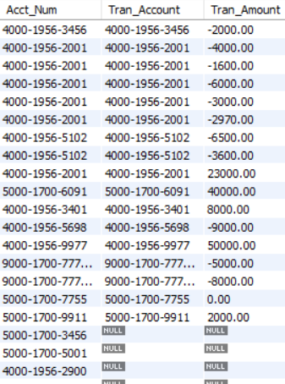
FULL JOIN - Example
Output:
Here, we see the records with
NULL transactions in TRANSACTION table
Missing accounts in ACCOUNT table
The purpose of FULL Join is to get a glance on all accounts and transactions , and take measures on
Accounts that are inactive without transactions
Or any Missing transactions of old accounts

Slide 80
CROSS JOIN

Slide 81
CROSS JOIN - Syntax
CROSS JOIN combines all rows from left and right tables
SELECT BC.Cust_id,
BC.Name,
MG.NOTICE
FROM CUSTOMER BC
CROSS JOIN MESSAGE MG
The result of the query gives an output that each customer is sent with all type of notifications present in the MESSAGE table

Slide 82
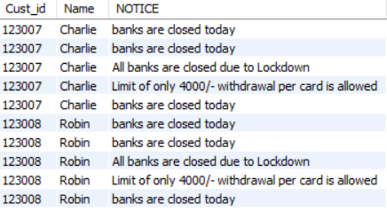
CROSS JOIN - Syntax
Output:
CROSS JOIN combines all rows from left and right tables
The result of the query gives an output that each customer is sent with all type of notifications present in the Bank_customer_Messages table.

Slide 83
Join multiple tables

Slide 84
JOIN MULTIPLE Tables - Example
Multi table JOINS are allowed when a complex report needs complete details from all the tables including customer details, their active accounts , transactions with business conditions
SELECT BC.cust_id,
BC.Name,
BC.Address,
BA.Acct_Num ,
BA.Balance ,
BT.Tran_Amount ,
BT.Channel
FROM CUSTOMER BC
INNER JOIN ACCOUNT BA
ON BA.cust_id=BC.cust_id
LEFT JOIN TRANSACTION BT
ON BA.Acct_Num =BT.Acct_Num

Slide 85
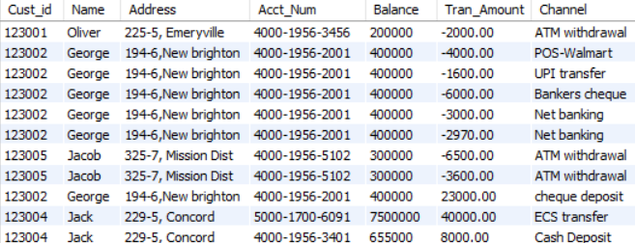
JOIN MULTIPLE Tables - Example
Output:
Multiple tables are joined with multiple type of JOINS like INNER / LEFT outer

Slide 86
In practise, Multi table JOINS are allowed when a complex report needs complete details from all the tables including customer details, their active accounts, transactions with business conditions.
There is no maximum limit on joining the tables. An expert can write queries on tables by joining 20- 30 tables easily

Slide 87
Rules for Multi Join Query
Number of Tables joining in a multi table queries should have at least (No.of tables – 1) joining conditions.
Ex: 4 tables when joined needs at least 3 or more joining conditions.
It is preferred to have unique column values in the driving tables especially when using INNER JOIN otherwise it leads to cross distribution of rows among the tables
CUST_ID in the CUSTOMER table is always unique , however the cust_id is repeated in ACCOUNT table since a customer has multiple accounts
Similarly Acct_Num is unique in ACCOUNT table but it is repeated in TRANSACTION table since there are many transactions for each account

Slide 88
Join Notations using (+) operator ( Non ANSI )
Supported in Oracle- RDBMS

Slide 89
JOIN Notations using (+) Operator - Syntax ( Non - ANSI )
(+) Operator can perform LEFT and RIGHT joins by simply changing the positions in the WHERE clause
Syntax: perform LEFT JOIN using (+)
SELECT BA.Acct_Num ,
BA.Balance_Amount ,
AT.Tran_Amount ,
AT.Channel
FROM ACCOUNT BA
TRANSACTION AT
WHERE BA.Acct_Num = AT.Account_Number(+)

Slide 90
JOIN Notations using (+) Operator - Syntax ( Non - ANSI )
Syntax: perform RIGHT JOIN using (+)
SELECT BA.Acct_Num ,
BA.Balance_Amount,
AT.Tran_Amount ,
AT.Channel
FROM ACCOUNT BA
TRANSACTION AT
WHERE
(+)BA.Acct_Num
=AT.Account_Number
AND BA.ACCOUNT_STATUS = 'ACTIVE'
(+) Operator is simply a replace RIGHT JOIN clause
By any means (+) operator is not added, then the Query will be converted to INNER JOIN. Developers should be familiar to write queries using (+) operator

Slide 91
Thank You

